Slide 1
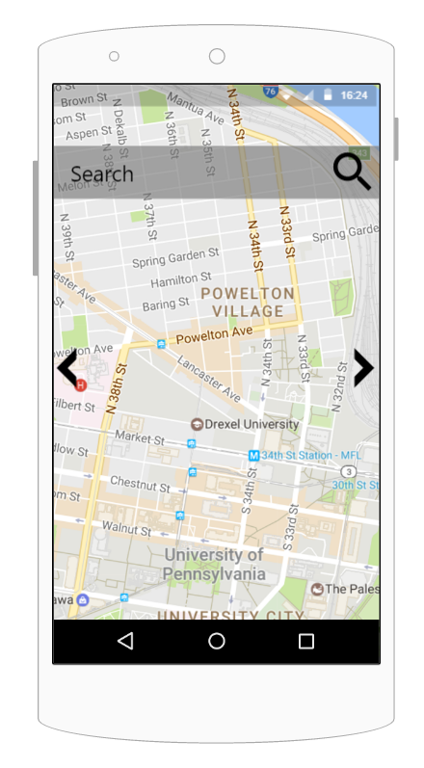
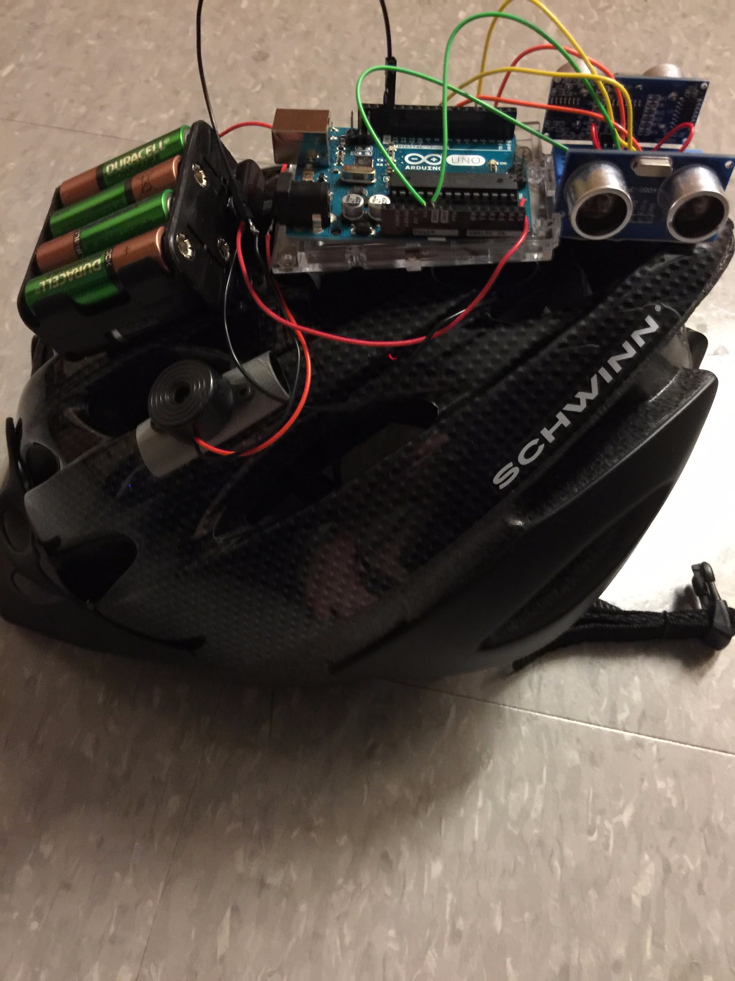
Elevate
A custom built safety helmet for recreational riders with a supported mobile application that supplements the riding experiencing.
CI 103 Phase
Team #46
Matthew Horger, Kevin Tayah, Jake Rauchen

Slide 2
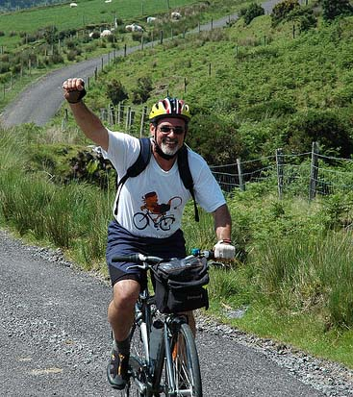
Motivation and Lessons Learned
Safety of riders, enjoyability for riders, professional uses (competitions, races, etc)
CI102 Lessons Learned
Helmet was functional with installed modules - needs more modules, reliability and security (weatherproofing)
Mobile Application - development of a specific application for one type of phone took too long
No way to figure out if the GPS data from the ride was accurate / mapped
Data was all for local end user via USB connection
No technical support for competitions or businesses

Slide 3


CI103 Scope
Critical:
Mobile application functionality ported to a website (Javascript)
Highlight and give directions for a user-entered route; give data on elevation and highlight hills (give information) for user to get a route to.
Allows for users to view it from an Android, iPhone, or computer
Helmet modules properly secured and installed
Collision module installed and able to record timestamped data
Reliable, rechargeable power source able to run helmet ~8 hours
Database and Content Management System
mySQL database for GPS coordinates
Google Maps Integration with Plone to provide waypoint tracking
User accounts (support, commercial user) to allow for helmet tracking and data analytics with content management system
Contact Business - Indego

Slide 4


CI103 Scope (cont)
Nice to have:
Port the website to a dedicated mobile application for Android
GPS/GPRS module for helmet for real-time data
Network connection between helmet and server
More data provided for users of their ride (speed, distance traveled)
Future Considerations
More data provided such as heart rate
Company outreach
IBX
Drexel University Skate Race

Slide 5


Approach - Technical
Mobile Application
Will utilize JavaScript to provide the backbone
Utilize HTML5 for mobile application view
Implement Google Maps API
Helmet
Arduino Uno with Ultrasonic modules and collision sensors
JSON Data for timestamp and collision / distance data
Database
MySQL database for JSON GPS Coordinates
Python Server to receive coordinates from a network connection / allow for users to connect
Zope to implement a HTML webpage with the database
Plone Content Management System to allow users to access data about their helmet

Slide 6

Approach - Management
Matt
Responsible for development of helmet
Responsible for development of database
Responsible for business presentations
Kevin
Responsible for design and implementation of web application
Responsible for helmet / application testing
Jake
Responsible for business research / connections
Responsible for database testing
Responsible for issue handling

Slide 7
Improvements (Major Deliverables)
Functional helmet with collision sensor and weatherproof case
Web based application for Google Maps API integration to provide elevation and other analytics for users
Must be able to viewed on mobile devices
Database connections with Plone CMS for users to track their helmet and rides using Google Maps API waypoints
Business connections to provide information about services / potential of product on commercial market

Slide 8
Timeline
Week 4-5
Have an algorithm to calculate elevation change and determine severity of a hill
Have a full functional helmet with all modules installed and secured
Start database foundations
Week 5-6
Testing of algorithm and connection of Google Maps API
Acquire helmet case / battery improvements
Finish database / start working on CMS
Week 6-7
Have position tracking finalized in web application / setup user accounts with CMS
Secure helmet case / business outreach
Week 7-10
Finish user testing / resolve any issues

Slide 9
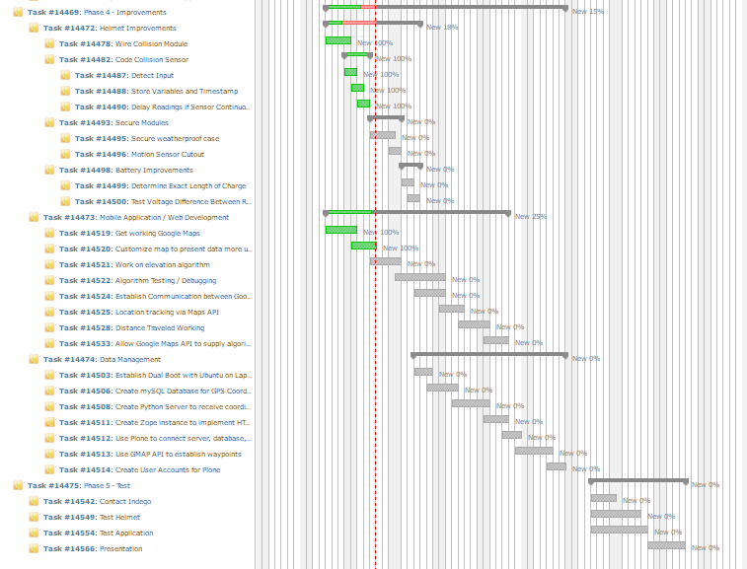

Slide 10
Any Questions? Thank you

